Slide 1
Ontologies and The Semantic Web CSE488 Course Project Pharmacy Management System
Abdelrahman Mohamed Shemies | 18P9565
Ahmed Amr Behairy | 18P5837
Daniel Tarek Lewis | 18P1185
Mahmoud Mohasseb | 20P2787

Slide 2
AGENDA
Ontology​
RDF
Instances
SparQL Queries
Front End

Slide 3
ONTOLOGY

Slide 4
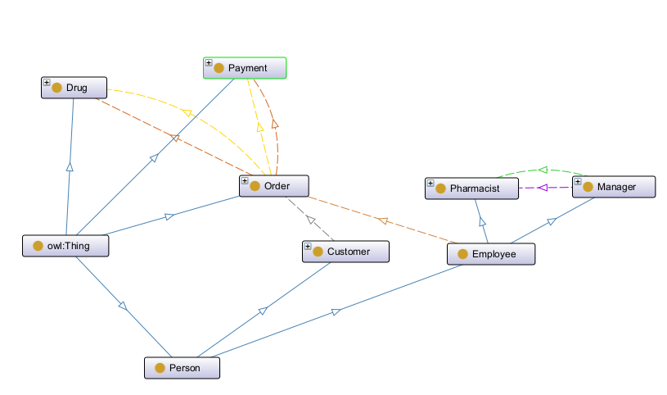

Slide 5
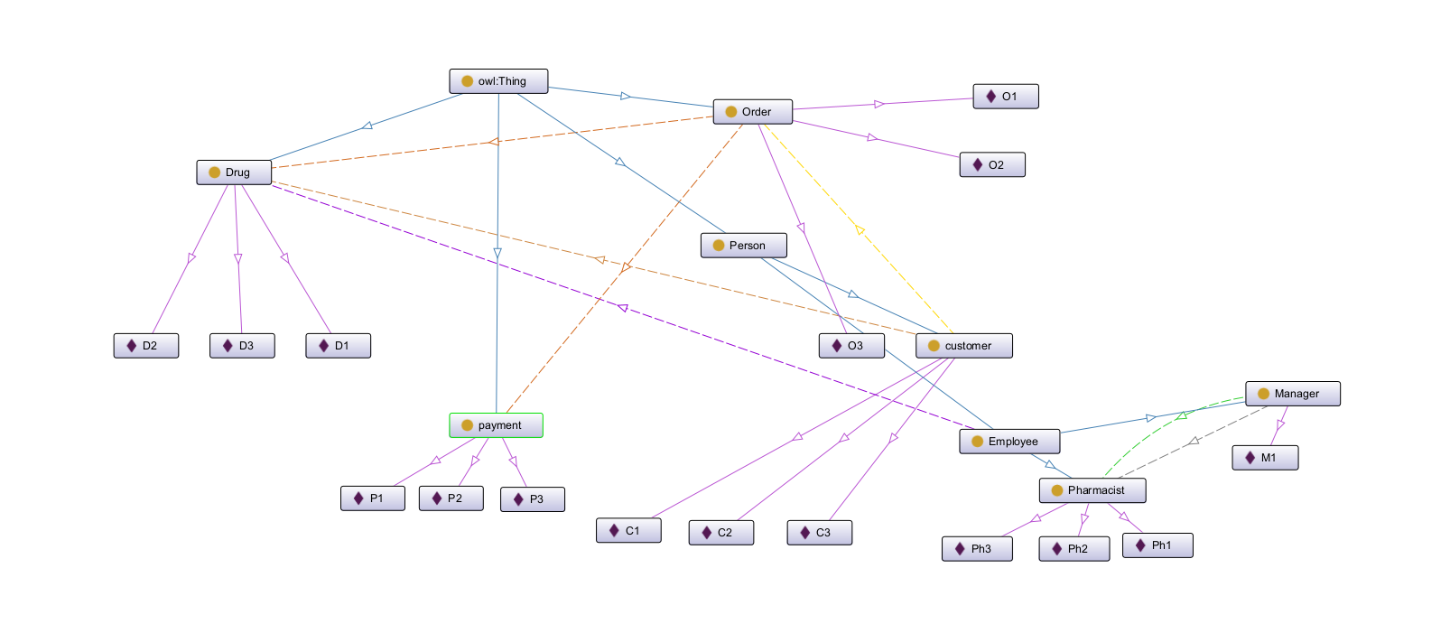

Slide 6
RDF

Slide 7
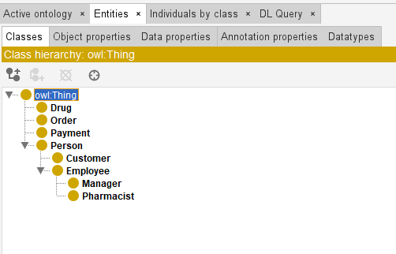
RDF
Entities
Person subclass of thing
Drug a subclass of thing
Payment subclass of thing
Order subclass of thing
Employee a subclass of person
Customer a subclass of person
Pharmacist subclass of person a subclass of employee
Manager a subclass of employee

Slide 8
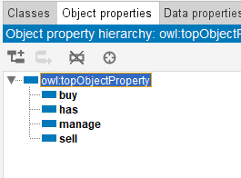
RDF
Object Properties
Buy (Customer buy Order)
Has (Order has Drug & Order has Payment)
Manage (Manger manage Pharmacist)
Sell (Pharmacist sell order)

Slide 9
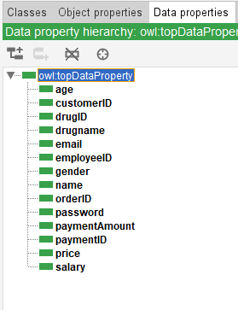
RDF
Data Properties
Age
customerID
drugID
drugname
email
employeeID
gender
name
orderID
password
paymentAmount
paymentID
price
salary

Slide 10
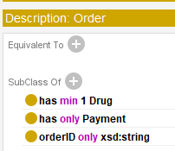
RDF
Constraints
Order has min 1 drug
Order has only one Payment

Slide 11

RDF
Constraints
Customer buy min 1 order

Slide 12
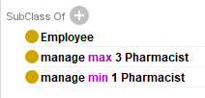
RDF
Constraints
Manager manage min 1 Pharmacist
Manager manage max 5 Pharmacist

Slide 13



Instances
Drug
Order
Payment

Slide 14



Instances
Person
Customer
Pharmacist
Manager

Slide 15
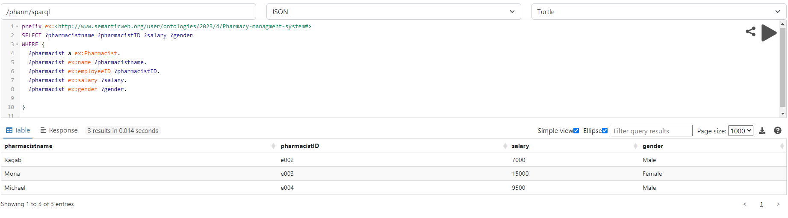
SparQL Queries
List all Pharmacists Listing their name , ID, Salary, and Gender

Slide 16
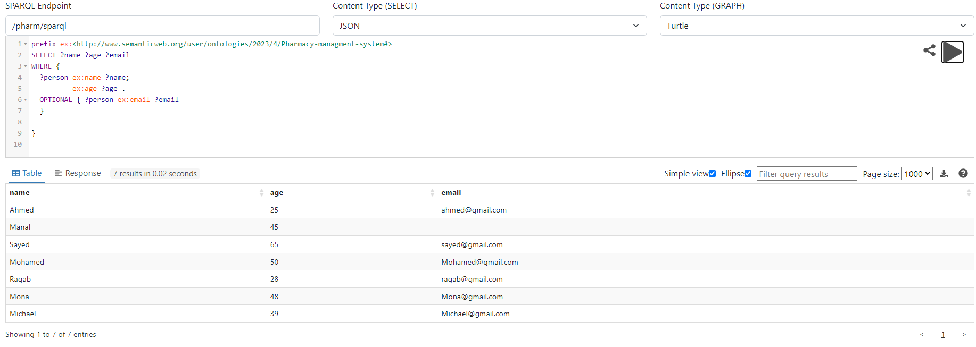
SparQL Queries
List all persons listing their name , age and email (Optional)

Slide 17
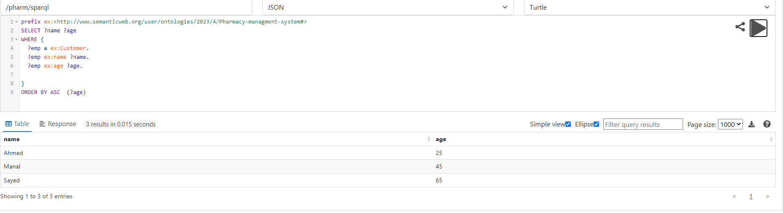
SparQL Queries
List all customers and arranging them ascendingly by age

Slide 18
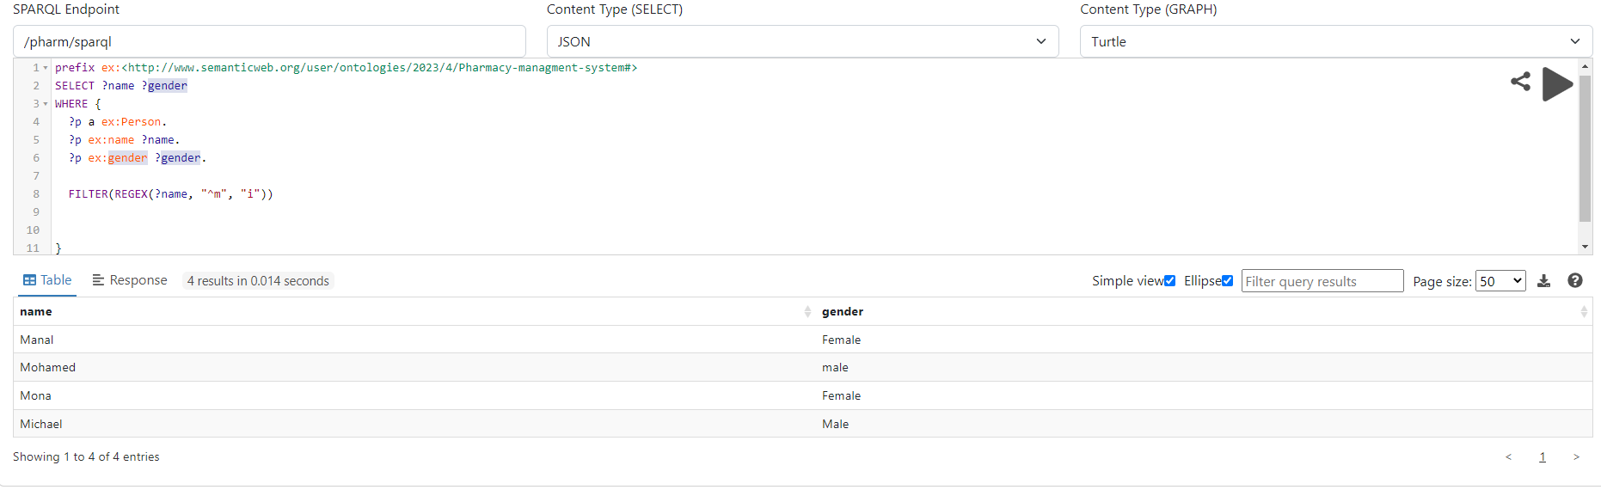
SparQL Queries
List all persons who starts with letter m (regex and filter) and their gender

Slide 19
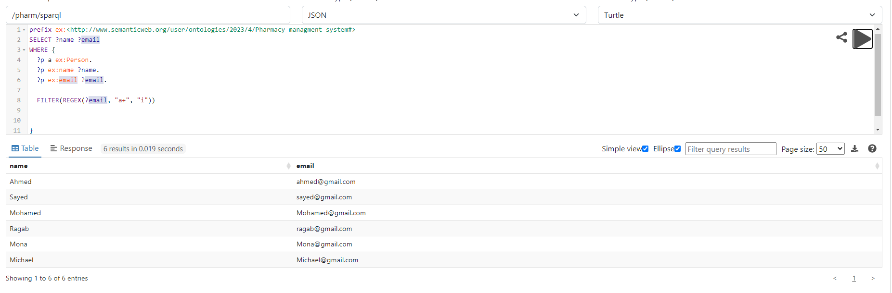
SparQL Queries
List all persons who have emails that include letter a (regex and filter) and their names

Slide 20
SparQL Queries
List all persons who have emails that include letter a (regex and filter) and their names

Slide 21
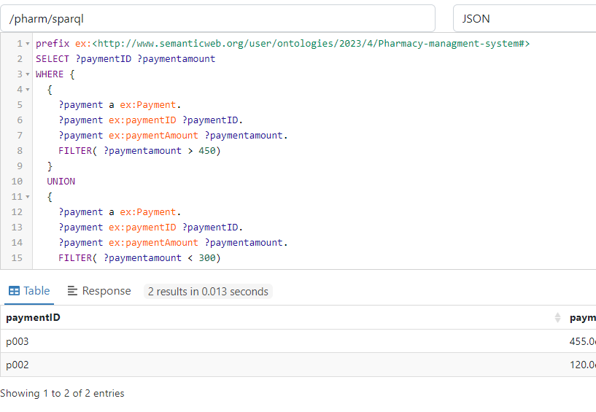
SparQL Queries
List all the Payments that have their amounts >450 UNION <300

Slide 22
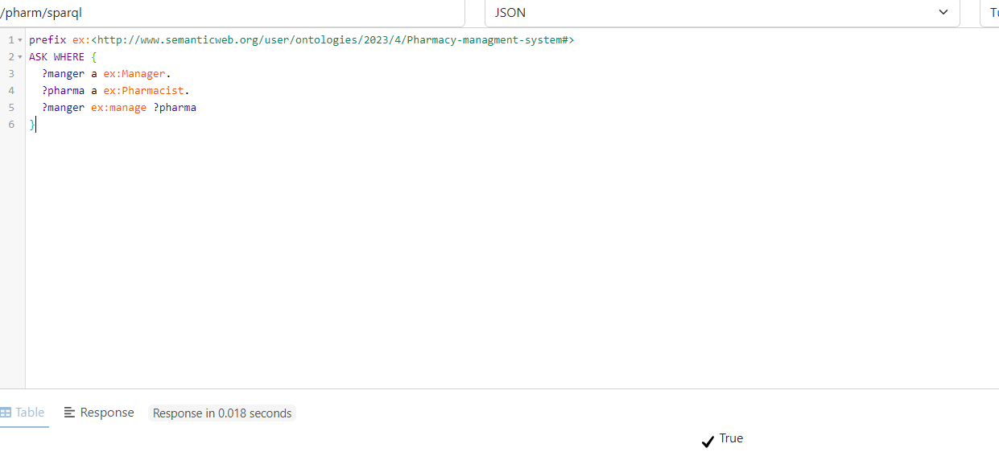
SparQL Queries
ASK if there is a manager who manage pharmacist

Slide 23
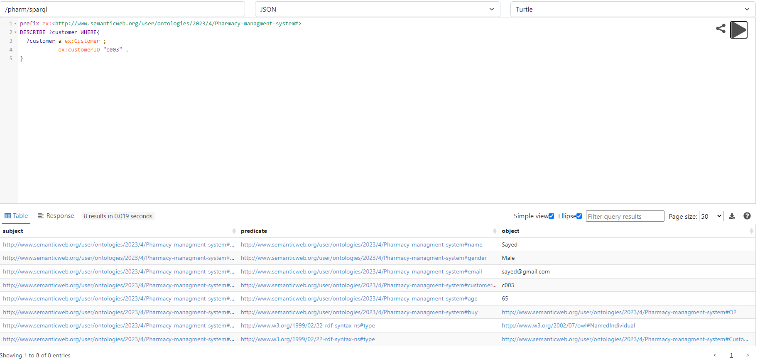
SparQL Queries
List all description of all orders that contain customer with customerID “c003”

Slide 24
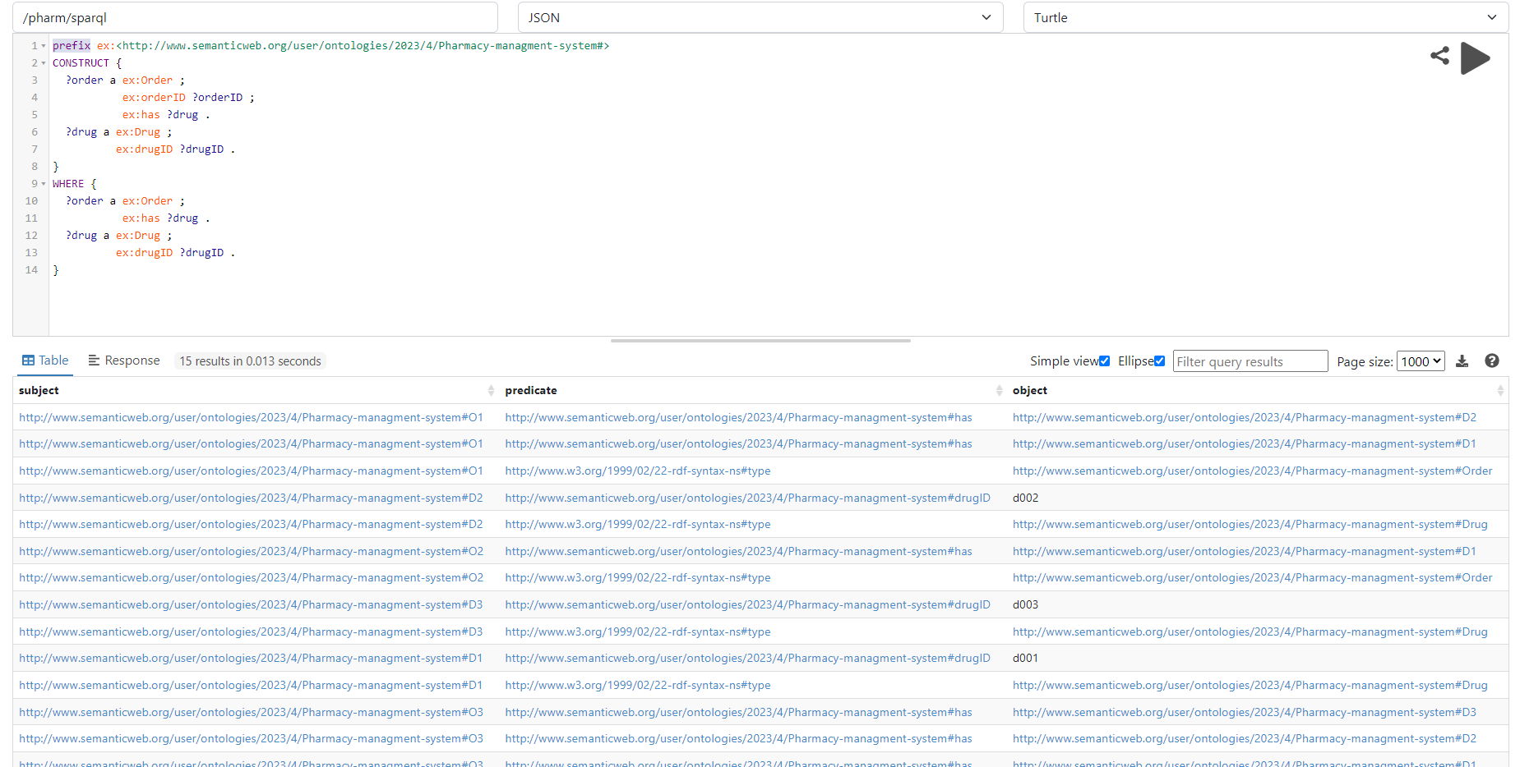
SparQL Queries
Construct a result set containing all orders and the drugs they contain.

Slide 25
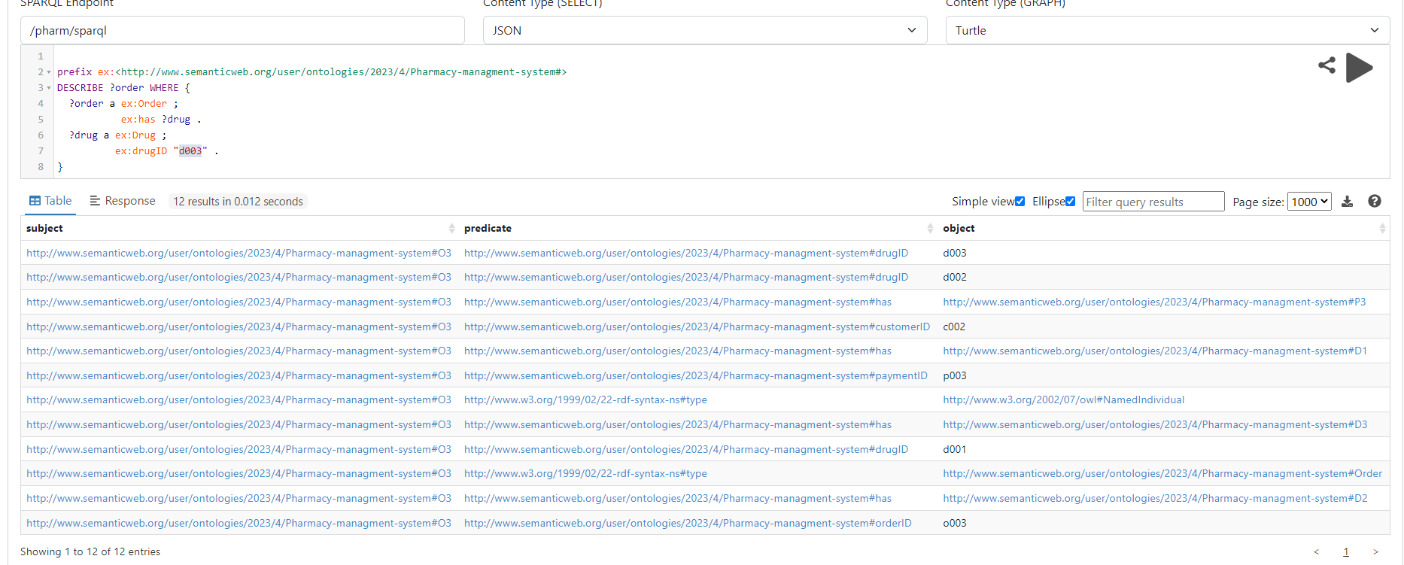
SparQL Queries
Obtain a description of all orders that contain a drug with drug ID "d003".

Slide 26
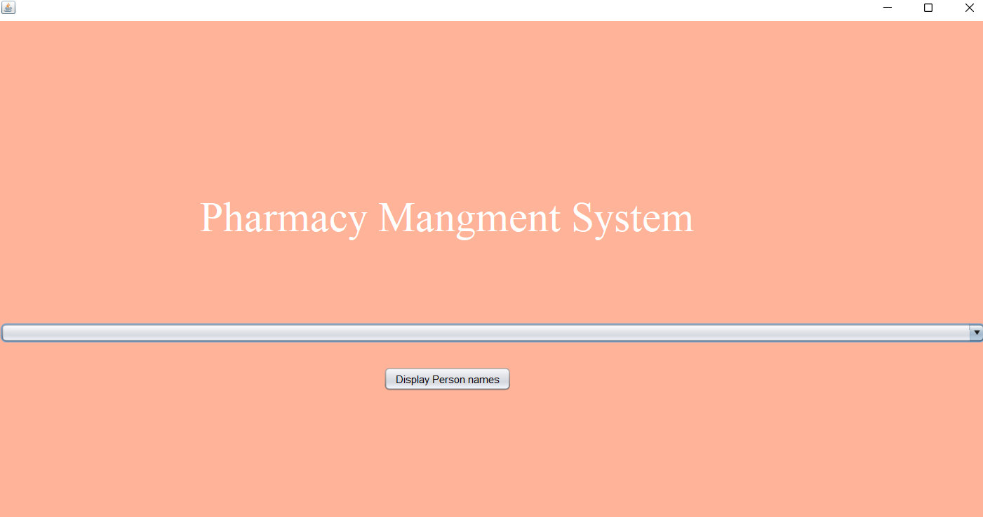
FrontEND

Slide 27
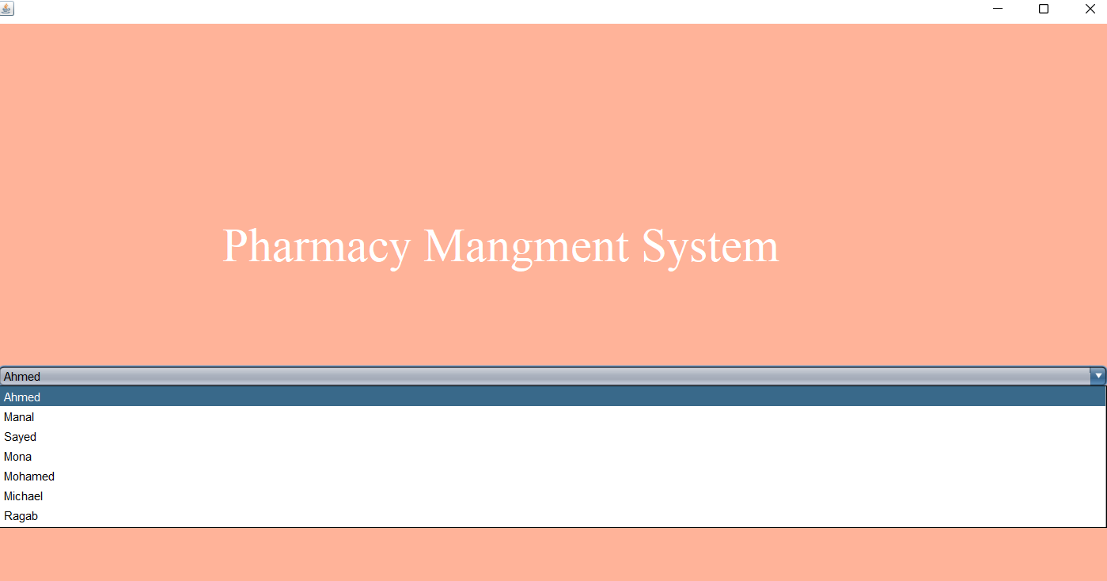
FrontEND

Slide 28
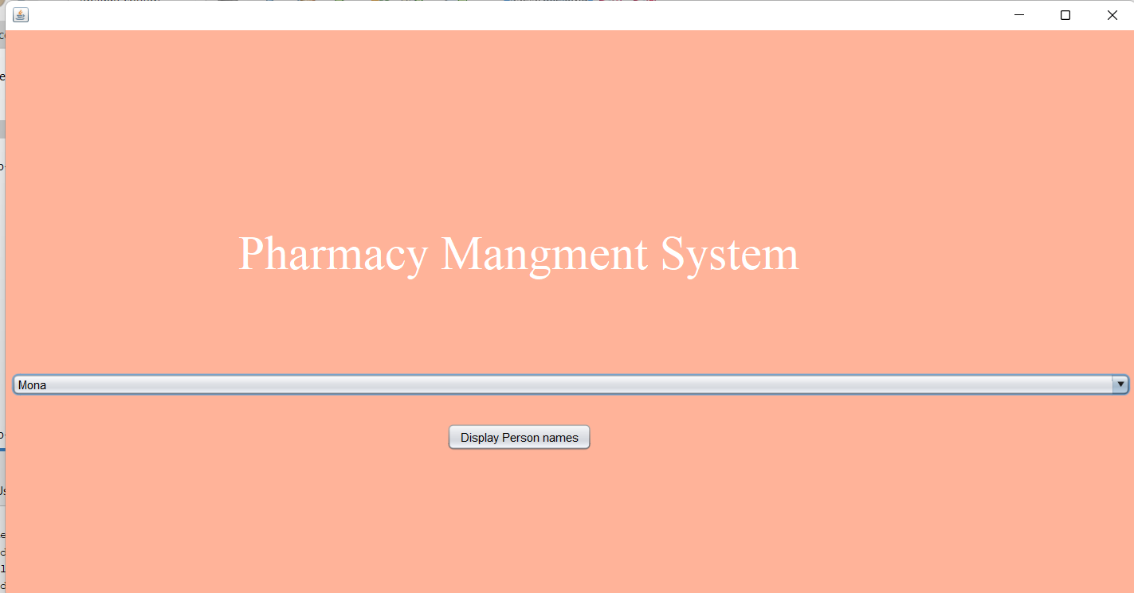
FrontEND

Slide 29
THANK YOU
Abdelrahman Mohamed Shemies | 18P9565
Ahmed Amr Behairy | 18P5837
Daniel Tarek Lewis | 18P1185
Mahmoud Mohasseb | 20P2787

